Slide 1
Cagamas – National Mortgage Corporation of Malaysia
2026 International Housing Finance Forum & ASMMA Annual Meeting
Housing Finance Forum: "Affordability, Technology, and Trends”
Panel Session 1: International Housing Finance Systems
8 June 2026

Slide 2



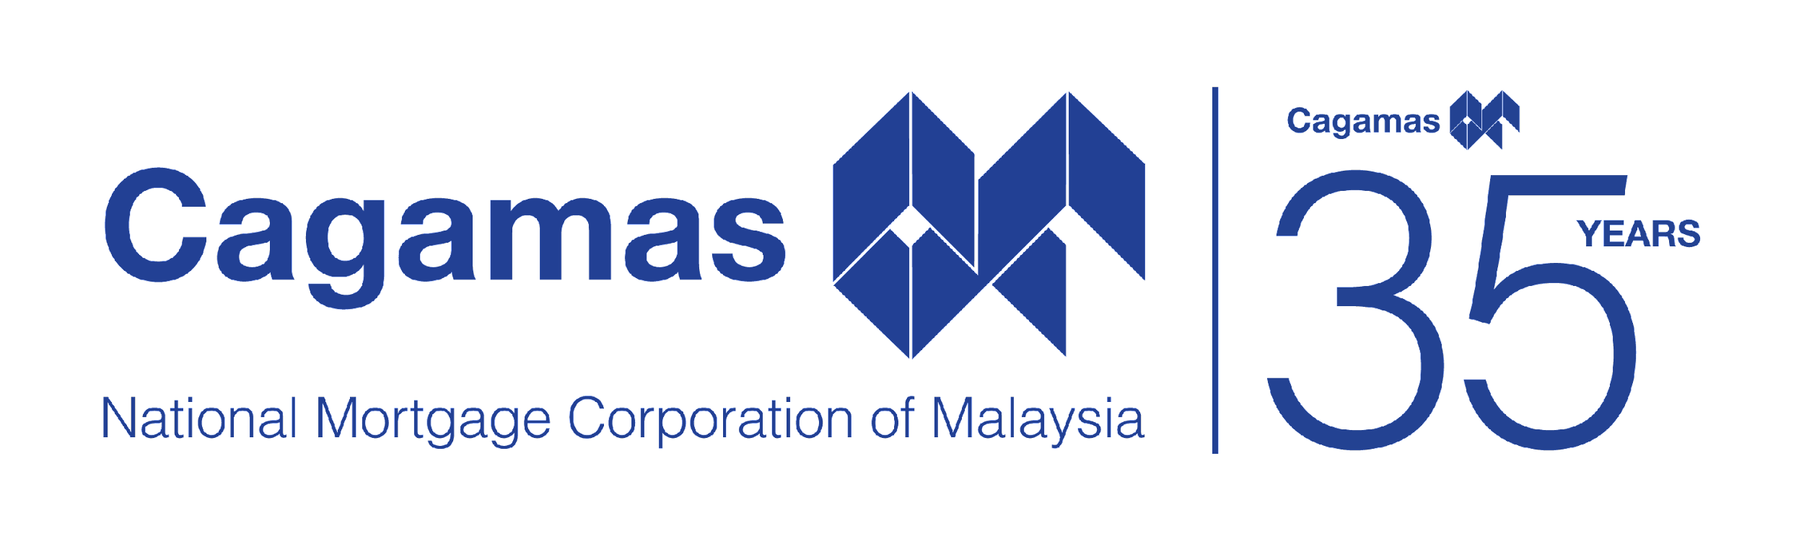



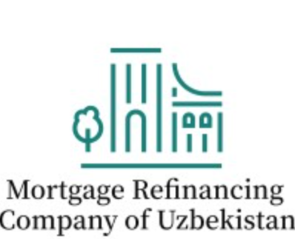





Strategic Alliance
Cagamas, as one of the founding members of ASMMA, continues to deepen regional and international collaborations to foster discussion between secondary mortgage market corporations
Notes:
We did not just go at it alone. We built networks and alliances around the globe and became one of the founding members of both ISMMA, the International Secondary Mortgage Market Association, and ASMMA in 2018, and the Asian Secondary Mortgage Market Association in 2915.
We work with our peers and deepen regional and international collaborations to foster discussion and understand best practices between secondary mortgage market corporations.

Slide 3
Cagamas’ Business Model
Mortgage Guarantee Programme (MGP)
Offers “first loss” protection on a mortgage porfolio while the mortgage assets remain on the banks’ books. MGP helps banks free up capital and rebalance risk
MGP
Purchase with Recourse (PWR)
Quick access to liquidity for banks' regulatory compliance needs
% of NOI | % of Liabilities
8.0% | 0.1%
% of NOI | % of Assets
10.0% | 75.7%
PWR
Guarantee Model
PWOR
Purchase Without Recourse (PWOR)
Banks can sell mortgages and other eligible assets to free up capital and rebalance portfolio risk
Capital Management Solution (CMS)
Supporting Tier-2 capital needs of FIs and DFIs
Liquidity
Model
Business Model
Securitisation
Model
CMS
% of NOI | % of Assets
1.9% | 4.1%
% of NOI | % of Assets
29.8% | 10.0%
Reverse Mortgage
RM
Reverse Mortgage (RM)
Retired homeowners can receive cash flow for life to boost their retirement income
Note: All figures are as at 31 Dec 2025
NOI is Net Operating Income
Notes:
PWR – Outstanding PWR loans RM39.7 billion
CMS - Outstanding subordinated debt supported under CMS is RM2.3 billion
RM - Cagamas has allocated RM100 million for this scheme
MGP - “My First Home Scheme” and “Youth Housing Scheme”¹ benefitted 109,060 applicants since inception in 2011, with a total financing value of RM25.7 billion
PWOR - Since 1987, Cagamas has purchased RM22.7 billion PWOR assets.

Slide 4
Cagamas’ Guarantee Business Model and Key Achievements
Mortgage Guarantee Programme
(Cagamas SRP)
1
2
3
4
My First Home Scheme
Youth Housing Scheme
First Home
Mortgage Guarantee Programme
Green Mortgage Guarantee Programme
Key Achievements:
110,854
RM26.0 bil (~USD6.5 bil)
94%
84%
Number of first-time homebuyers who obtained financing guaranteed by Cagamas
Total approved financing value
First-home homebuyers from the lower income group (Bottom 40% of household income)
Financing for affordable housing (RM300k or ~USD75k and below)

Slide 5


Regulatory mandates support the development of Cagamas
Bank Negara Malaysia
(central bank)
Securities Commission Malaysia (capital market regulator)
Mandated to preserve financial stability and ensure sustainable credit intermediation
Supports structures that reduce asset-liability mismatches in mortgage lending
Provides regulatory incentives / clarity for sale of housing loans, enabling secondary market activity
Anchored Cagamas’ establishment to strengthen housing finance resilience and continuity
Mandated to develop a deep, efficient and resilient capital market – including bond market
Supports securitisation and issuance of high-quality debt instruments
Facilitates diversified investor base and long-term funding pools
Enables institutions like Cagamas to create investable mortgage-backed assets and scale funding

Slide 6
Thank you

